Slide 1
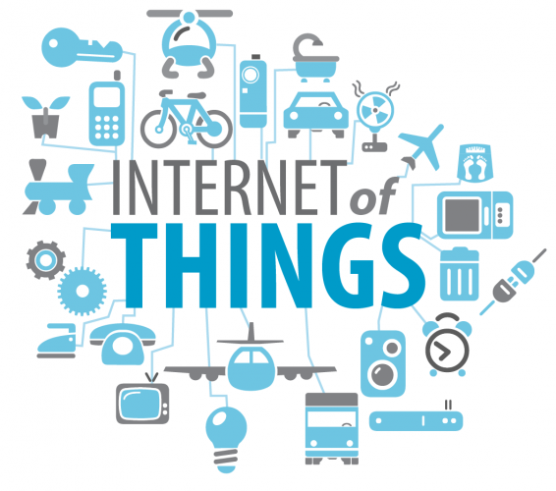
20EC503PE - INTERNET OF THINGS
IOT-T.YUVARAJA

Slide 2
Module-1
INTRODUCTION TO IoT
Internet of Things – characteristics- Physical Design- Logical Design - IoT Enabling Technologies.

Slide 3
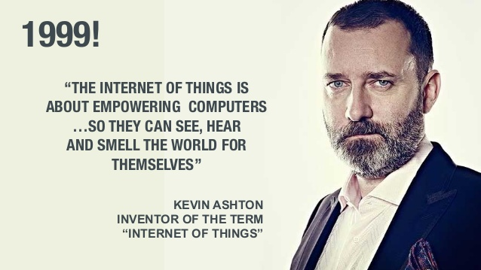
Internet of Things
Kevin Ashton Invented the Term "Internet of Things"

Slide 4
Internet of Things(Definition)
The Internet of Things (IoT) describes the network of physical objects—“things”—that are embedded with sensors, software, and other technologies for the purpose of connecting and exchanging data with other devices and systems over the internet.

Slide 5
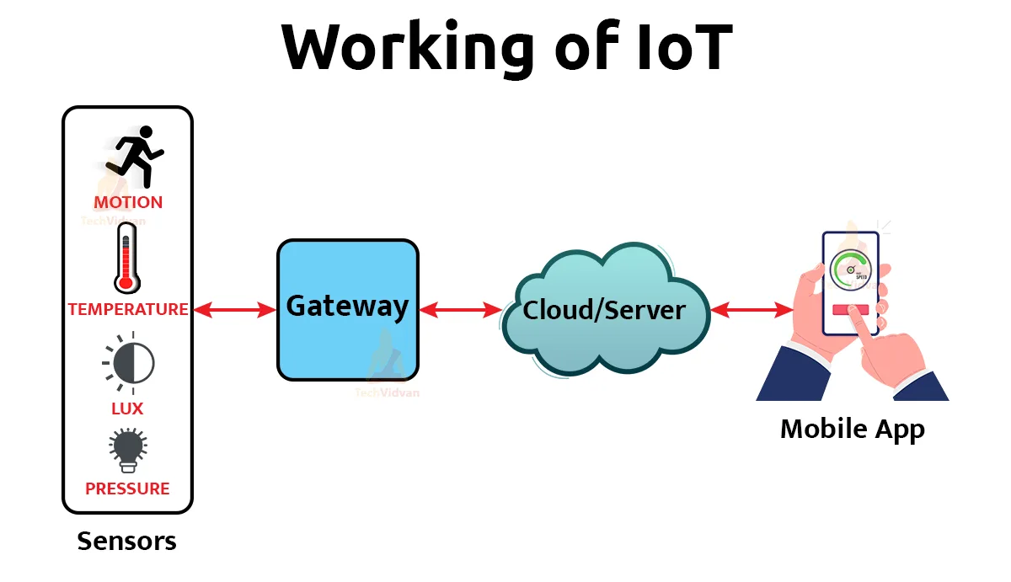


Slide 6
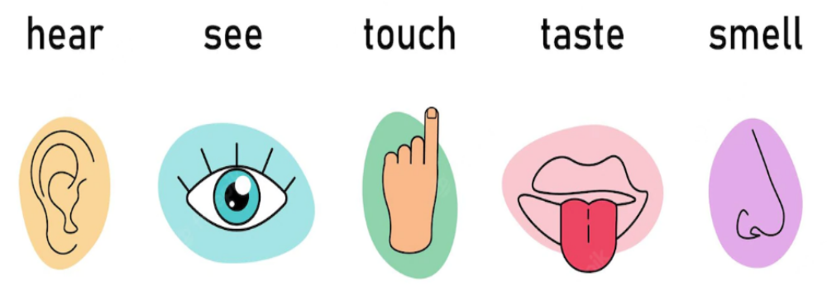
Sensor

Slide 8
Characteristics of IoT
Dynamic & Self-Adapting
Self-Configuring
Interoperable Communication Protocols
Unique Identity
Integrated into Information Network

Slide 9
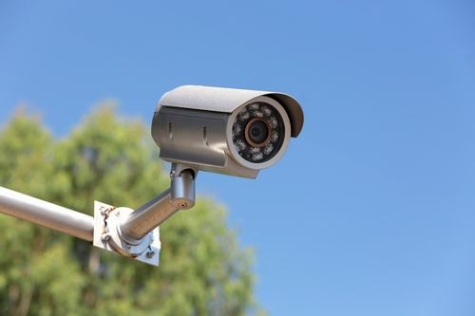
Characteristics of IoT
1)Dynamic & Self-Adapting
surveillance camera
It should be adaptable to work in different conditions(Normal & Infrared)
Different(dynamic) light situations (Day & Night).

Slide 10
Characteristics of IoT
2)Self-Configuring
setup the network
Software upgrade

Slide 11
Characteristics of IoT
3)Interoperable Communication Protocols
IoT allows different devices (different in architecture) to communicate with each other as well as with different network.
For ex: MI Phone is able to control the smart AC and smart TV of different manufacturer.

Slide 12
Characteristics of IoT
4)Unique Identity
The devices which are connected to the internet have unique identities
i.e. IP address

Slide 13
Characteristics of IoT
5)Integrated into Information Network
The IoT devices are connected to the network to share some information with other connected devices.
The devices can be discovered dynamically in the network by other devices.
Eg: If a device has wifi connectivity then that will be shown to other nearby devices having wifi connectivity

Slide 15
Physical Design of IoT
Things/Devices and protocols that are used to build an IoT system.
Things/Devices are called Node Devices and every device has a unique identity that performs remote sensing, actuating and monitoring work.
Protocols→establish communication between the Node devices and servers over the internet.

Slide 16
Physical Design of IoT
Things in IoT
IoT Protocols

Slide 17
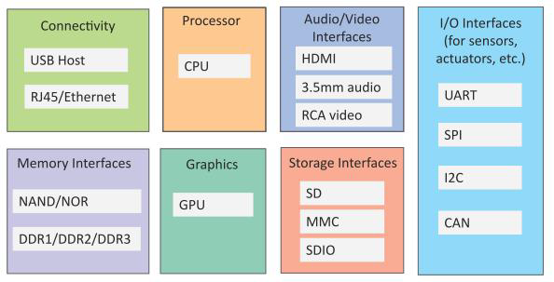
Things in IoT
Generic block diagram of an IoT Device
An IoT device may consist of several interfaces for connections to other devices,both wired and wireless.

Slide 18
Things in IoT
IoT Device
Connectivity
Processor
Audio/Video Interfaces
Input/Output interface
Memory Interfaces
Storage Interfaces
Graphics

Slide 19
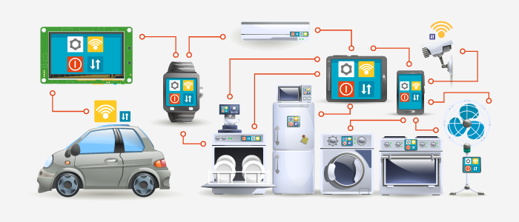
Things in IoT
IoT Devices

Slide 20
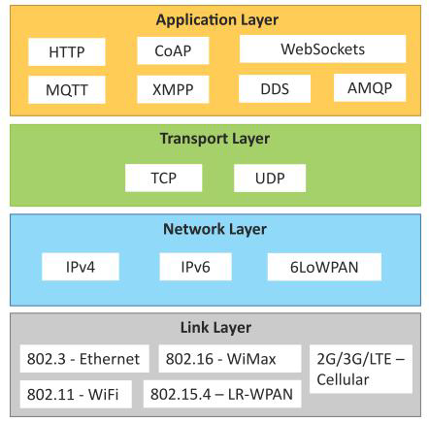
Physical Design of IoT
IoT Protocols

Slide 21
IoT Protocols
1)Link Layer
2)Network/Internet Layer
3)Transport Layer
4)Application Layer

Slide 22
IoT Protocols
1)Link Layer Protocols:
802.3-Ethernet: IEEE802.3 is collection of wired Ethernet standards
  802.3 → co-axial cable
  802.3i → copper twisted pair
  802.3j → fiber optic
  802.3ae → Ethernet over fiber
  802.11-WiFi: IEEE802.11 is a collection of wireless LAN(WLAN) communication standards.
  802.11a → 5GHz band
  802.11b → 2.4GHz band
  802.11g →2.4GHz band
  802.11n →2.4/5GHz band
  802.11ac →5GHz band
  802.11ad →60Ghzband

Slide 23
IoT Protocols
  1) Link Layer Protocols:
  802.16 - WiMax:
  IEEE802.16 is a collection of wireless broadband standards.
  WiMax provide data rates from 1.5 Mb/s to 1Gb/s.
  802.15.4- LR-WPAN:
  IEEE802.15.4 is a collection of standards for Low Rate Wireless Personal Area Network(LR-WPAN).
  ZigBee
  Provides data rate from 40kb/s to250kb/s.
  2G/3G/4G-Mobile Communication:
  Data rates from 9.6kb/s(2G) to up to100Mb/s(4G)

Slide 24
IoT Protocols
2)Network/Internet Layer Protocols:
IPv4:
Internet Protocol version 4
32 bit address.
Total= 2³²addresses
IPv6:
Internet Protocol version6
uses 128 bit address
Total= 2¹²⁸ addresses
6LOWPAN:
IPv6 over Low power Wireless Personal Area Network
Operates in 2.4 GHz frequency range
Data transfer 250 kb/s.

Slide 25
IoT Protocols
3) Transport Layer Protocols:
TCP:
  Transmission Control Protocol
  Connection oriented
  Reliable (Guaranteed delivery)
  Feedback(Acknowledgment)
  UDP:
  User Datagram Protocol
  connectionless protocol
  Unreliable
  No Feedback(No Acknowledgment)

Slide 26
IoT Protocols
4)Application Layer Protocols:
  HTTP:
  Hyper Text Transfer Protocol
  Follow request- response model
  Stateless protocol.
  CoAP:
  Constrained Application Protocol
  M2M applications
  Uses client- server architecture.
  WebSocket:
  Allows full duplex communication over a single socket connection.
  MQTT:
  Message Queue Telemetry Transport
  light weight messaging protocol
  publish-subscribe model.
  Uses client server architecture.

Slide 27
IoT Protocols
  4)Application Layer Protocols:
  XMPP:
  Extensible Message and Presence Protocol
  real time communication and streaming XML data between network entities.
  Support client-server and server-server communication.
  DDS:
  Data Distribution Service
  Device-to-device or machine-to-machine communication.
  Uses publish-subscribe model.
AMQP:
  Advanced Message Queuing Protocol
  Supports both point-to-point and publish-subscribe model.

Slide 29
Logical Design of IoT
1) IoT Functional Blocks
2) IoT Communication Models
3) IoT Communication APIs

Slide 30
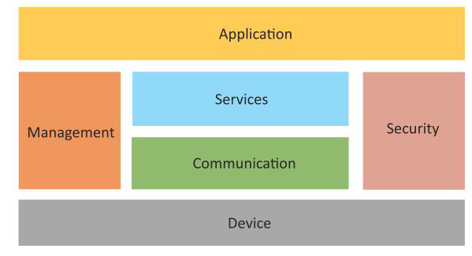
Logical Design of IoT
IoT functional Blocks

Slide 31
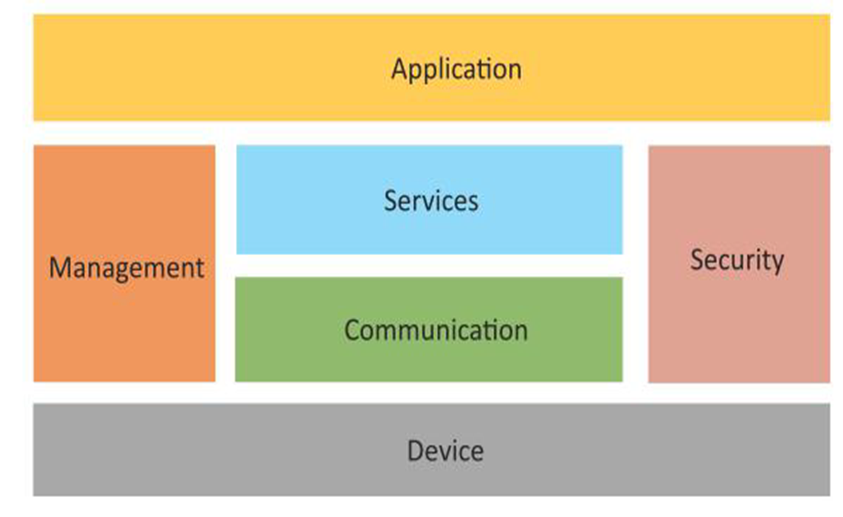
IoT functional Blocks
Device
Communication
Services
Management
Security
Application

Slide 32
IoT functional Blocks
Device :
An IoT system comprises of devices
provide sensing, actuation, monitoring and control functions.
Communication:
Handles the communication for the IoT system.
Services:
Device monitoring services
Device control services
Data publishing services
Device discovery services

Slide 33
IoT functional Blocks
Management:
provides various functions to govern the IoT system.
Security:
secures the IoT system
providing functions such as
Authentication
Authorization
Message and content integrity
Data security
Application:
provide an interface that the users can use to control and monitor various aspects of the IoT system.
Applications also allow users to view the system status and view or analyze the processed data.

Slide 34
IoT communication models
Request-Response communication model
Publish-subscribe communication model
Push-pull communication model
Exclusive-pair communication model

Slide 35
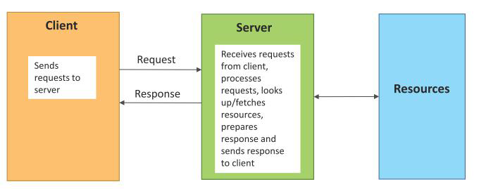
IoT communication models
Request-Response communication model

Slide 36
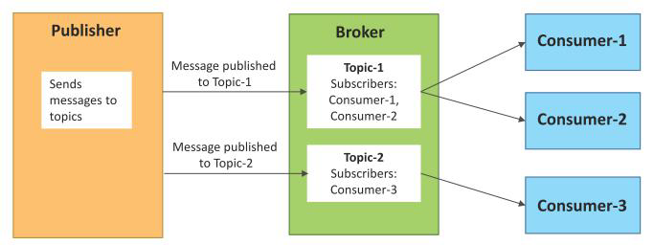
IoT communication models
2)Publish-subscribe communication model

Slide 37
IoT communication models
2)Publish-subscribe communication model
It involves publishers, brokers and consumers.
Publishers are the source of data. Publishers send the data to the topics which are managed by the broker.
Publishers are not aware of the consumers.
Consumers subscribe to the topics which are managed by the broker.
When the broker receives data for a topic from the publisher, it sends the data to all the subscribed consumers.

Slide 38
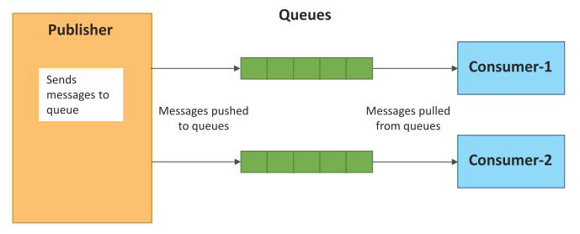
IoT communication models
3)Push-pull communication model

Slide 39
IoT communication models
3)Push-pull communication model
Publishers push the data to queues and the consumers pull the data from the queues.
Publishers do not need to be aware of the consumers.
Queues also act as a buffer

Slide 40
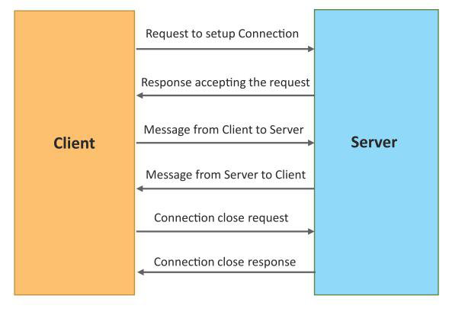
IoT communication models
4)Exclusive-pair communication model

Slide 41
IoT communication models
4)Exclusive-pair communication model
Bi-directional, fully duplex communication model
Once connection is set up it remains open until the client send a request to close the connection.
Client and server can send messages to each other after connection setup.

Slide 42
IOT Communication APIs
REST-based Communication API
Web Socket based communication API

Slide 43
IOT Communication APIs
1)REST-based Communication API
Representational State Transfer (REST)
Request -Response communication model

Slide 44
IOT Communication APIs
1)REST-based Communication API
Client-server
Stateless
Cacheable
Layered system
Uniform interface
Code on demand

Slide 45
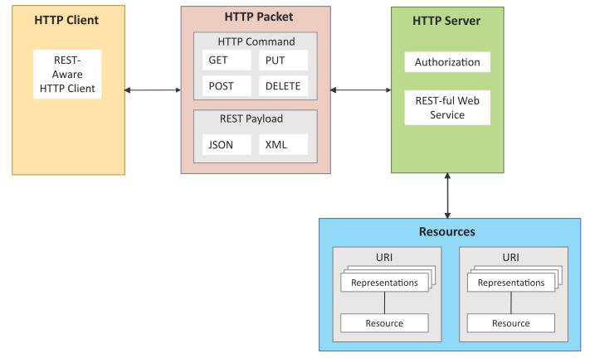
IOT Communication APIs
1)REST-based Communication API

Slide 46
IOT Communication APIs
1)REST-based Communication API
Representational State Transfer (REST) is a set of architectural principles by which you can design web services and web APIs.
REST APIs follow the request –response
communication model.

Slide 47
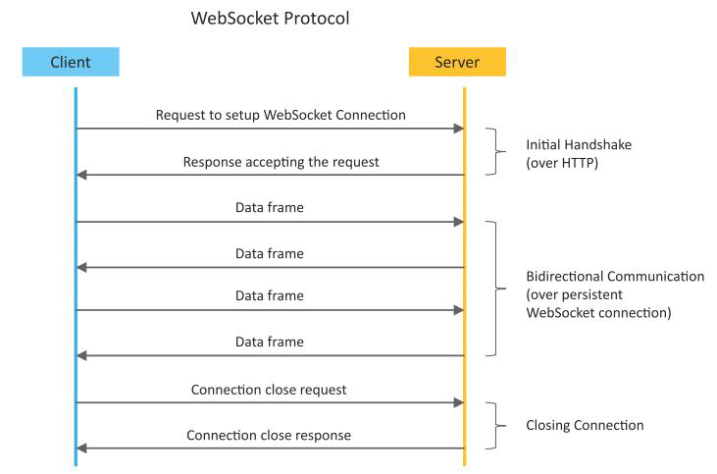
IOT Communication APIs
2)Web Socket based communication API

Slide 48
IOT Communication APIs
2)Web Socket based communication API
WebSocket APIs allow bidirectional, full duplex communication between clients and servers.
WebSocket APIs follow the exclusive pair communication model.
Websocket handshake
WebSocket APIs reduce the network traffic and latency
WebSocket is suitable for IoT applications that have low latency or high throughput requirements.

Slide 49
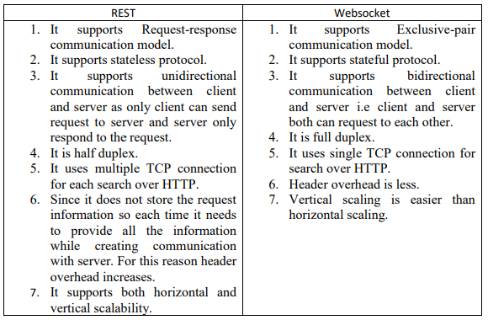
Difference between REST and Websocket:

Slide 51
IoT Enabling Technologies
Wireless sensor networks
Cloud computing
Big Data analytics
Embedded systems
Communication protocols

Slide 52
IoT Enabling Technologies
Wireless Sensor Networks(WSN)
WSN consists of a number of
1)End-nodes
2)Routers
3)coordinator

Slide 53
IoT Enabling Technologies
1) Wireless Sensor Networks(WSN)
End Nodes →sensors attached to them
Router→Routing the data packets from end-nodes to the coordinator.
Coordinator collects the data from all the nodes.
Coordinator also act as a gateway that connects the WSN to the internet.
Protocol→Zigbee

Slide 54
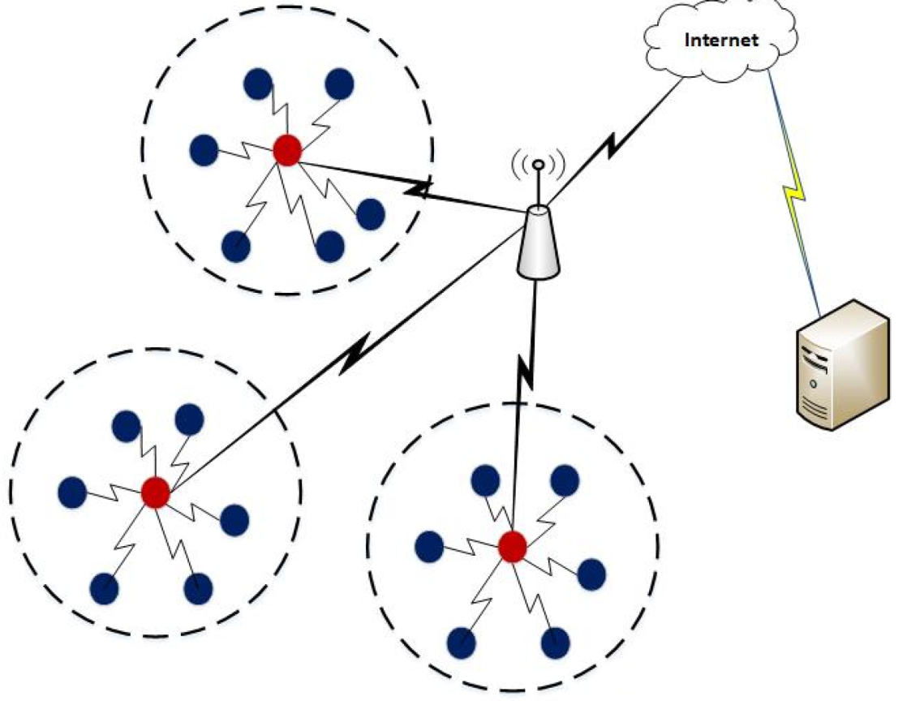
IoT Enabling Technologies
1) Wireless Sensor Networks(WSN)

Slide 55
IoT Enabling Technologies
Example of WSNs:
Weather Monitoring system
Indoor Air Quality monitoring system
Soil Moisture Monitoring system
Surveillance systems
Health Monitoring systems

Slide 56
IoT Enabling Technologies
Wireless sensor networks
Cloud computing
Big Data analytics
Embedded systems
Communication protocols

Slide 57
IoT Enabling Technologies
2)Cloud Computing
cloud computing is the delivery of computing services—including servers, storage, databases, networking, software, analytics, and intelligence—over the Internet (“the cloud”) to offer faster innovation, flexible resources, and economies of scale.

Slide 58
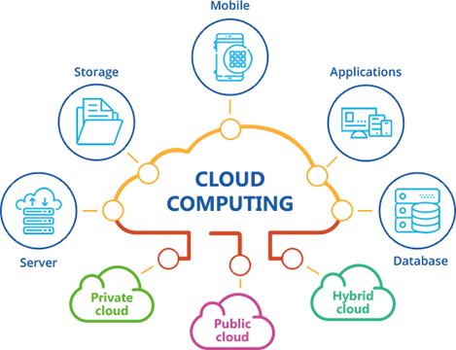
IoT Enabling Technologies
2)Cloud computing

Slide 59
IoT Enabling Technologies
2)Cloud computing
Cloud computing is the delivery of different services through the Internet, including data storage, servers, databases, networking, and software.
Cloud-based storage makes it possible to save files to a remote database and retrieve them on demand.

Slide 60
IoT Enabling Technologies
2)Cloud computing
1) Infrastructure-as-a-Service(IaaS):
Example:Google Compute
2) Platform-as-a-Service(PaaS):
Example: Google App Engine
3) Software-as-a-Service (SaaS):
Example: Microsoft Office 365

Slide 61
IoT Enabling Technologies
Wireless sensor networks
Cloud computing
Big Data analytics
Embedded systems
Communication protocols

Slide 62
IoT Enabling Technologies
3)Big Data analytics
Big data refers to large amount of data.
It cannot be stored, processed and analyzed using traditional database like (Oracle, MySQL).

Slide 63
IoT Enabling Technologies
3)Big Data analytics
It involve several steps starting from
Data cleaning
Data munging
Data processing
Data visualization

Slide 64
IoT Enabling Technologies
3)Big Data analytics
Sensor data →weather monitoring stations.
Machine sensor data →Industrial and energy
systems
Health and fitness data
Data →location and tracking of vehicles.
Data →retail inventory monitoring systems.

Slide 65
IoT Enabling Technologies
3)Big Data analytics
Characteristics:(3V)
1)Volume
2) Velocity
3)Variety

Slide 66
IoT Enabling Technologies
Wireless sensor networks
Cloud computing
Big Data analytics
Embedded systems
Communication protocols

Slide 67
IoT Enabling Technologies
4)Embedded systems
  Embedded system =Hardware + Software
  To perform Specific task
  Key components are
    Microprocessor or microcontroller
    Memory (RAM, ROM, Cache),
    Networking units (Ethernet, Wi-Fi adapter),
    Input/output units (Display, Keyboard, etc)
    storage (flash memory)
  They use some special types of processor such as digital signal processor, graphics processor and application specific processor).

Slide 68
IoT Enabling Technologies
5)Communication protocols
Protocol is nothing but rules and regulations.
Backbone of the IoT system
It allow devices to exchange data over the network.

Slide 69
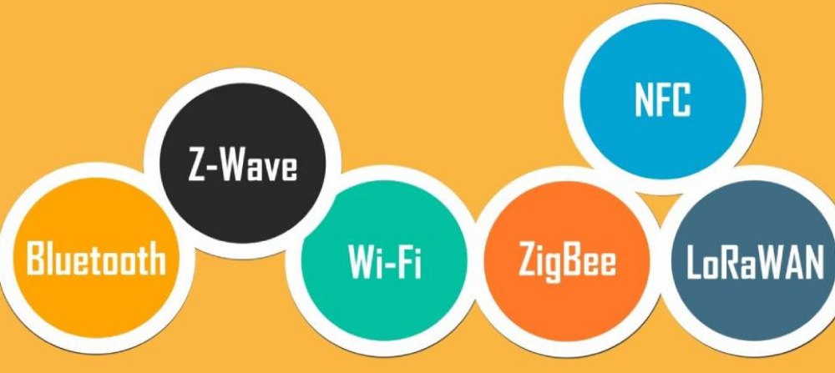
IoT Enabling Technologies
5)Communication protocols

